Slide 1



Dental Disease Detection
Presentation by Amna , Abdullah , Umair
Bachelors in CS| 2020-2024
CUI, Sahiwal Campus

Slide 2



Supervisor | Dr. Waqas Ahmed
Co-Supervisor | Dr. Javed Ferzund
● Trafﬁc accidents have become a major reason of deaths
throughout the world.
● But one major reason that causes signiﬁcant number of

Slide 3
GROUP MEMBERS
Registration # | Name | CGPA
Fa20-BCS-123 | Umair Ali | 2.95
Fa20-BCS-151 | Amna Zahid | 3.77
Fa20-BCS-153 | Abdullah Shafique | 3.08

Slide 4
Overview
Introduction
Related Work
Problem
Objectives
Methodology
Implementation
Result
Future Plans
Conclusion

Slide 5
INTRODUCTION-I
AI and medical image processing aid in diagnosing oral disorders.
Early detection improves oral health, self-esteem, and quality of life.
Common oral disorders include dentigerous cysts, pericoronitis, supernumerary teeth, chronic periodontitis, osteomyelitis, and sinusitis.

Slide 6
INTRODUCTION-II
Technology like Vision Transformers and YOLO enhances disease identification from radiographic images.
Timely intervention prevents tooth structural loss and related issues.
AI-driven early detection reduces long-term financial burdens by minimizing the need for extensive and costly treatments.

Slide 7

Problem Statement
Difficulty in diagnosing oral illnesses due to a lack of precise diagnostic tools.
Delayed diagnosis leads to significant consequences such as tooth loss, discomfort, and health issues.
Dental practitioners often lack comprehensive diagnostic capabilities during routine checkups.

Slide 8
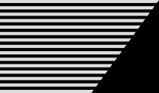
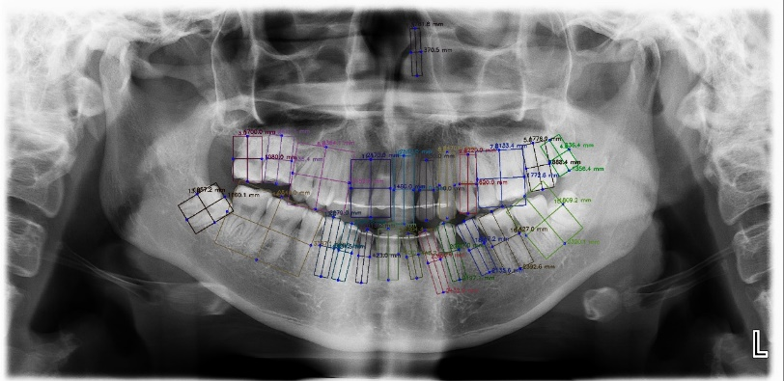

Proposed Solution
Develop a cutting-edge website utilizing AI-based technology for diagnosing dental illnesses from radiographic images.
The system employs AI algorithms to analyze each tooth individually, identifying potential diseases or abnormalities.

Slide 9

OBJECTIVES
DETECTION
Implement the YOLO-based real-time object detection approach to provide quick and efficient detection of caries in dental radiographs.
CLASSIFICATION
Develop a robust classification system capable of categorizing detected dental abnormalities into specific classes, periodontitis, and oral cancer.

Slide 10


METHODOLOGY
Detection & Classiﬁcation
Generate comprehensive diagnostic reports for dental practitioners, including YOLO-based abnormality detection, multi-class classification, and diagnostic confidence scores, enhancing clinical decision-making
Generate comprehensive diagnostic reports for dental practitioners, including detection results, classifications, and diagnostic confidence scores, enhancing clinical decision-making
Reporting

Slide 11
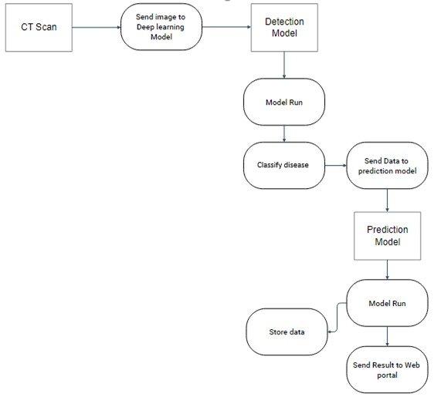
Architecture

Slide 12
IMPLEMENTATION
PHASE 1
SRS
SDD
A simple model of object detection
PHASE 2
Pending
PHASE 3
Pending

Slide 13

RESULT
A UNET model is trained on a image dataset:
91% accuracy
Dental Dataset

Slide 14


FUTURE PLANS
PHASE 2 extra
PHASE 3
Deployment on
Website
Advanced model with Dental dataset
work

Slide 15
CONCLUSION
Our integrated system, combining YOLO-based detection and multi-class classification, offers comprehensive diagnostic reports with high diagnostic confidence and interpretability, empowering dental practitioners in clinical decision-making for improved patient care.

Slide 16

THANK YOU
Presentation by Amna , Umair , Abdullah
Bachelors in CS | 2020-24
CUI, Sahiwal Campus

